Slide 1


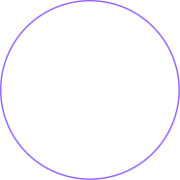
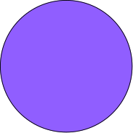
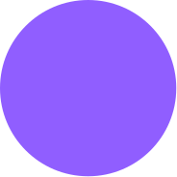
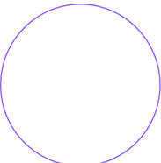

AI-Driven Wine Recommendation Chatbot
Vino-Sage: AI & Machine Learning Focus
Shivam Joshi

Slide 2

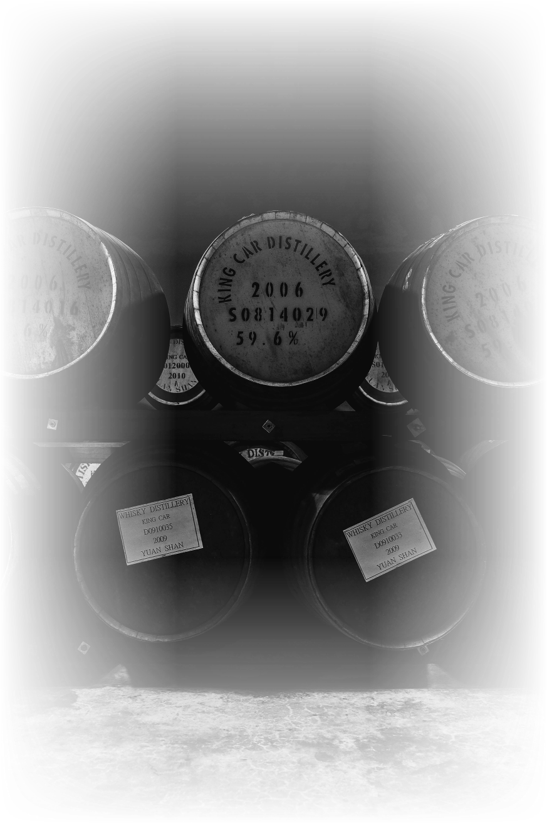

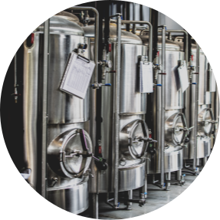
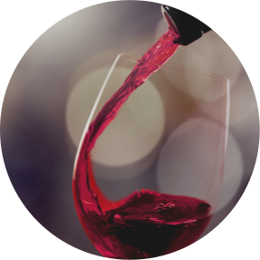

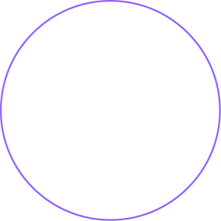
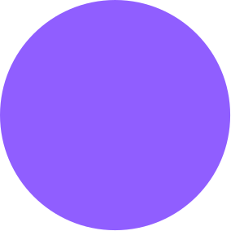

Vino-Sage
Data Management & MongoDB
1st
2nd
3rd
4th
Wine data collected via Vivino web scraping (Scrapper.py): product links, wine facts, taste characteristics, images
Data cleaning pipeline (Cleaning.py): deduplication, feature extraction, wine type extraction, imputation with XGBoost, final CSV output
Additional datasets (intent, entity, RAG source) curated/augmented via ChatGPT
Storage in MongoDB Atlas 'wine_recommendations' DB: collections wines, users, reviews, chat_history with Atlas Search indexing

Slide 3

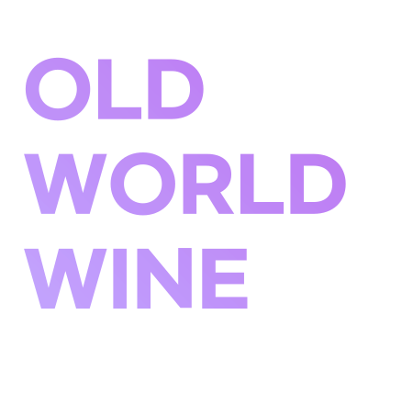
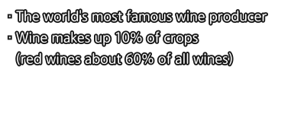
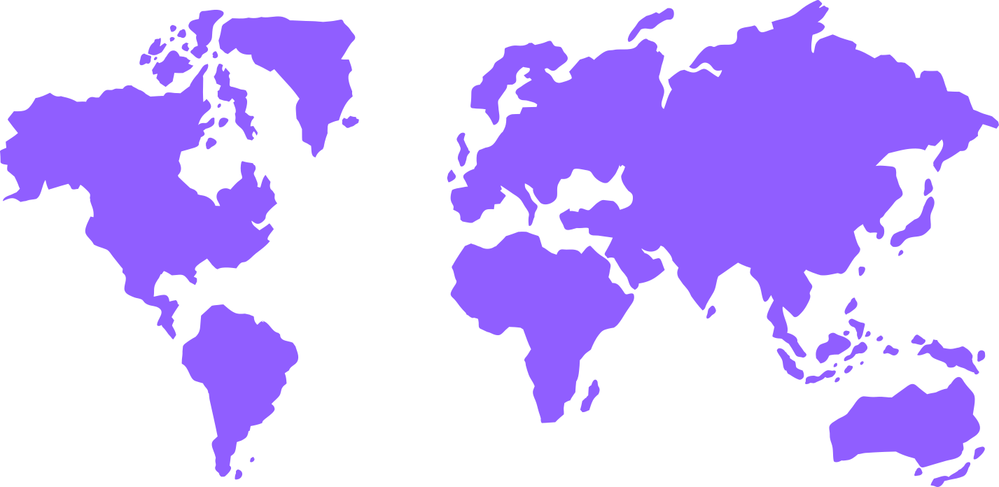
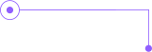
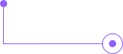
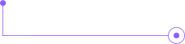
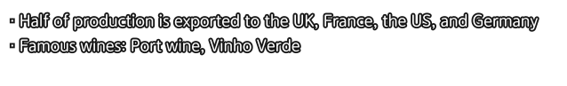
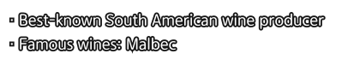
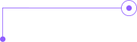
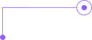
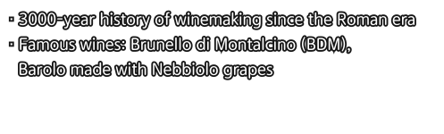
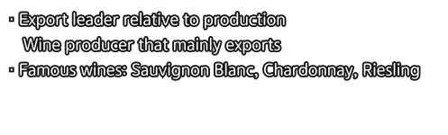
Vino-Sage
Characteristics
by origin
France
USA
· Cheaper than European wines and with
good quality
· Strategically manufactures to the tastes
of consumers in the countries it exports to
Portugal
Argentina
NEW
WORLD
WINE
Italy
Chile

Slide 4


Vino-sage
Problem Statement & Motivation
01
02
03
Consumers face difficulty selecting wines tailored to their taste.
Need for personalized, data-driven recommendations at scale.
Leveraging AI to bridge knowledge gap and enhance user experience.

Slide 5


Vino-sage
AI & ML Project Objectives
01
02
03
04
Develop NLU pipelines for intent and entity understanding.
Implement hybrid search combining keyword and semantic retrieval.
Augment responses with expert wine pairing advice via RAG.
Deliver coherent, personalized recommendations using LLMs.

Slide 6
Vino-sage
NLU Pipeline Overview
01
02
Intent Classification with DistilBERT fine-tuned on wine queries.
Named Entity Recognition using BERT with custom BIO tagging.

Slide 7
Vino-sage
Intent Classification
01
02
03
04
Training: 3 epochs, LearningRate=
0.00002,
batch size=4
Dataset: sample_intent_data.json with intents: recommend
wine, foodpairing, productdetails
Tokenization: truncation & padding to max_length= 64.
Evaluation: accuracy metrics per epoch for model selection.
Entity Extraction (NER)
01
02
03
04
Labels: WINE_TYPE, GRAPE_VARIETY, REGION, PRICE_RANGE, FOOD_PAIRING.
Training: 5 epochs, batch size=8, evaluation strategy per epoch.
Token alignment: fast tokenizer with offset mappings for BIO scheme.
Post-processing: merge entities, remove low-confidence & stopwords.

Slide 8
Vino-sage
Retrieval Engine
01
02
03
04
Keyword Search: MongoDB Atlas Search pipeline with full-text & fuzzy match.
Semantic Search: SentenceTransformer embeddings + FAISS index for similarity.
Hybrid Ranking: combine keyword and semantic scores (α=0.4).
Dynamic Filters: price, type, region applied from NLU outputs.
05
06
07
08
Retrieval-Augmented Generation (RAG)
Source: 'What to Drink with What You Eat' PDF loaded via PyPDFLoader.
Chunking: RecursiveCharacterTextSplitter (chunk_size=500, overlap=100).
Embedding: HuggingFaceEmbeddings & FAISS vectorstore.
Context Injection: retrieve top-K passages for food-pairing queries.

Slide 9

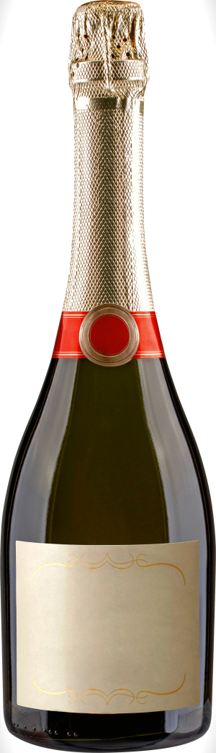
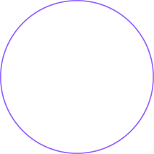

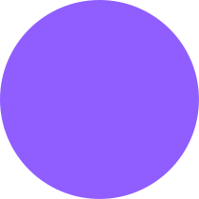
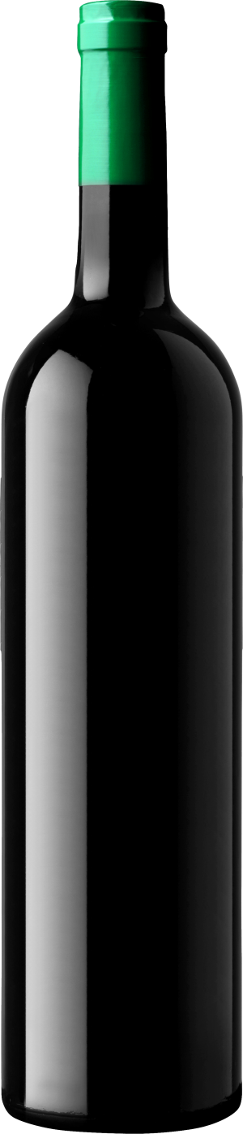
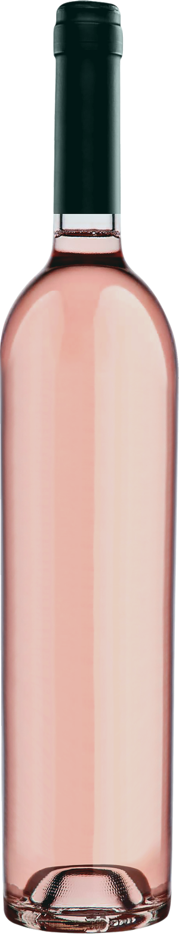

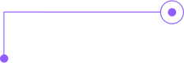
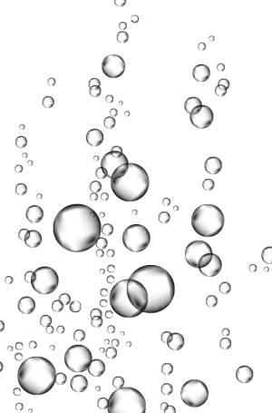
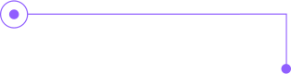

Miri Wine Class
02
LLM Response Generation
Model: GPT-4 via OpenAI API with temperature=0.7, max_tokens=1200.
Prompt Builder combines chat history, retrieved wines, and RAG context.
Structured Format: numbered lists, wine details, serving tips, food pairings
Follow-up Handling
detect and elaborate on previous recommendations.

Slide 10
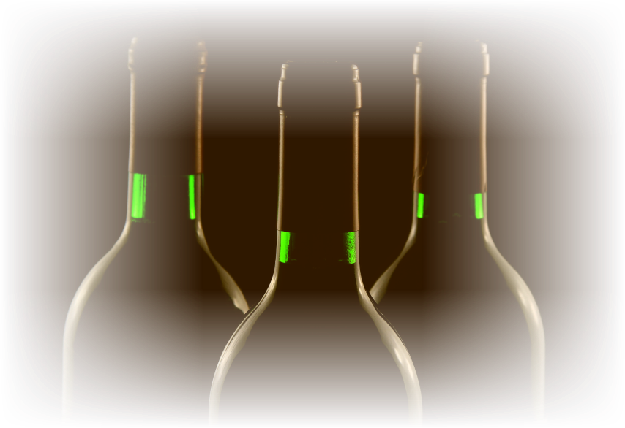


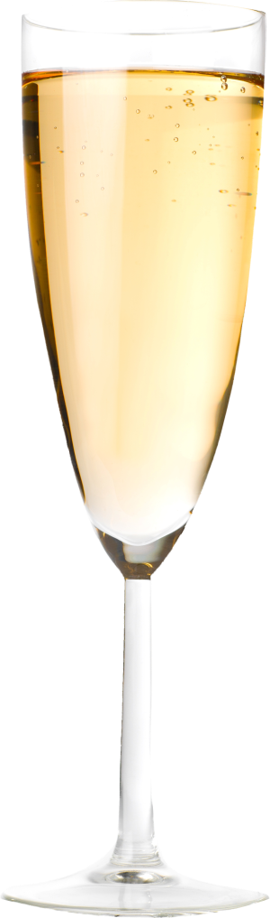

Vino-Sage
Front-End Overview
01
02
03
04
React.js with Material-UI for UI components and theming.
ChatWidget & ChatWindow for AI interaction, responsive design.
Filtering & Listing: Showcasing 8003 wines and details Page, pagination, Framer Motion cues.
Services: Axios-based layer for chat, wine, review APIs.

Slide 11
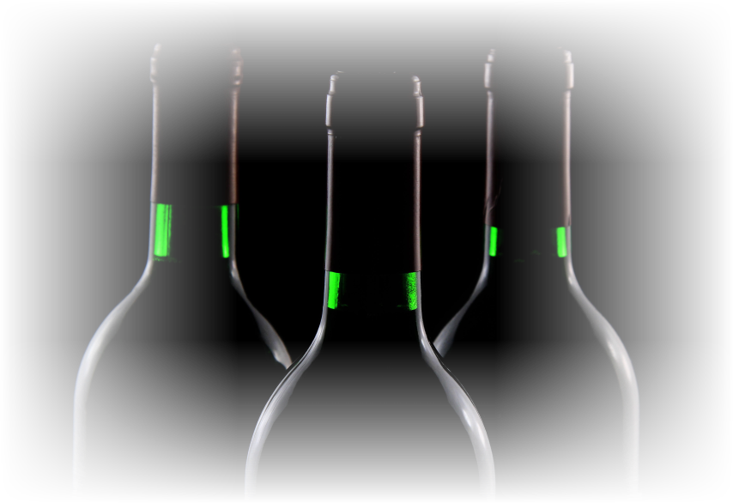


Vino-Sage
Back-End Overview
01
02
03
FastAPI: routes for auth, users, wines, reviews, chat with JWT auth
Core Modules: NLU, retrieval_engine, rag_module, response_generator.
Database: Motor AsyncIOMotorClient connecting to MongoDB Atlas.

Slide 12



Vino-Sage
Vino-Sage Project Architecture Overview
Layered Components
• React UI (MUI, Framer‑Motion) – chat & catalogue
• FastAPI backend – REST /routers
• ResponseGenerator – orchestrates NLU ▸ Retrieval ▸ RAG ▸ GPT‑4
• NLU Service – DistilBERT intent + BERT NER
• Hybrid Retrieval – MongoDB Atlas Search + MiniLM/FAISS
• RAG Vector Store – What‑to‑Drink PDF ➜ FAISS index
• Data Layer – MongoDB Atlas + Images CSV
End‑to‑End Request Flow
1. User query posted via React ➜ /chat
2. FastAPI passes query to ResponseGenerator
3. NLU extracts intent & entities (+price fallback)
4. Hybrid Retrieval ranks wines; RAG adds expert passages
5. GPT‑4 formats response; FastAPI returns JSON
6. React renders bubbles & recommendation cards

Slide 13



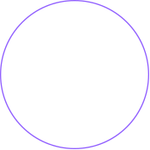
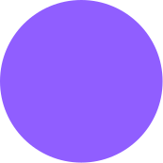
Vino-Sage
Thank You
Q&A

